Slide 1
Predicting the Popularity of Mashable.com
News Articles
Team 2 Anant Khandelwal, Akshay Pokharkar Chi-Hua Wu, Josh Wilder, Vicky Pang

Slide 2
Agenda
Exploration & Pre-processing
Models & Comparison
Business Problems &
Dataset Introduction
Results & Conclusions
Q & A

Slide 3
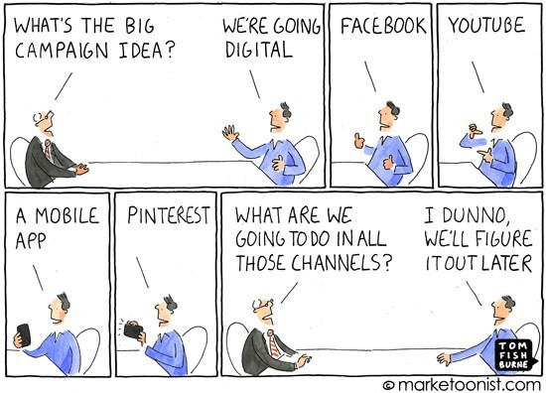

Slide 4
Business Problems & Dataset Introduction
1

Slide 5
Business Problem
News articles are shared on social media, but how can we determine which news or topics are most popular?
The goal is to create and develop a predictive model to show the numbers of shares in social networks based on several features of online news.

Slide 6
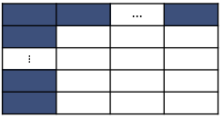

Dataset Introduction
Article Titles
Keywords
images
61
weekday of posting
Natural Language Processing
39K
The number of Shares
(> 2,900)
Notes:
The sample dataset can be accessed from: https://archive.ics.uci.edu/ml/datasets/Online+News+Popularity
61 attributes describing 39,797 Mashable articles
Each article is one row
Continuous and categorical variables
Includes information about article titles, keywords, images, weekday of posting.
Sentiment analysis including classifying words as positive or negative and measures of polarity (extremity)

Slide 7
Exploration & Pre-processing
2

Slide 8
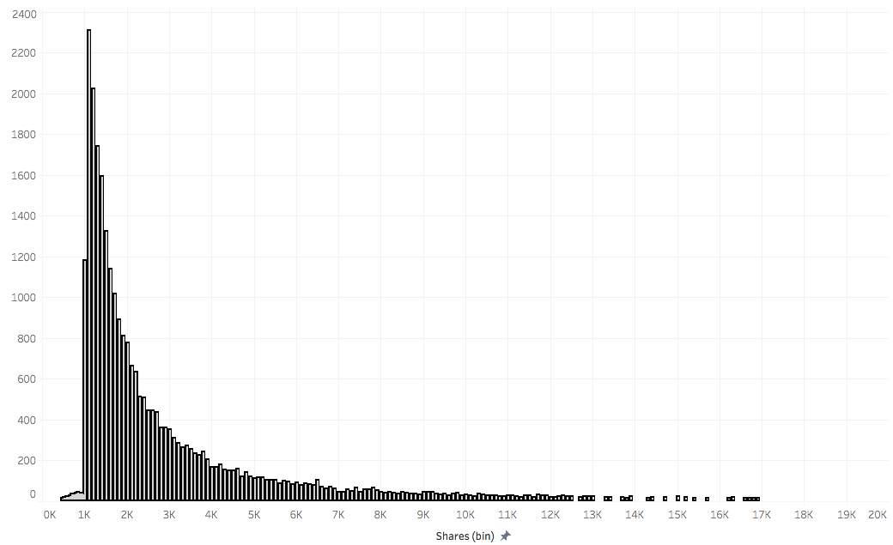
The distribution for the numbers of shares
The number of articles

Slide 9
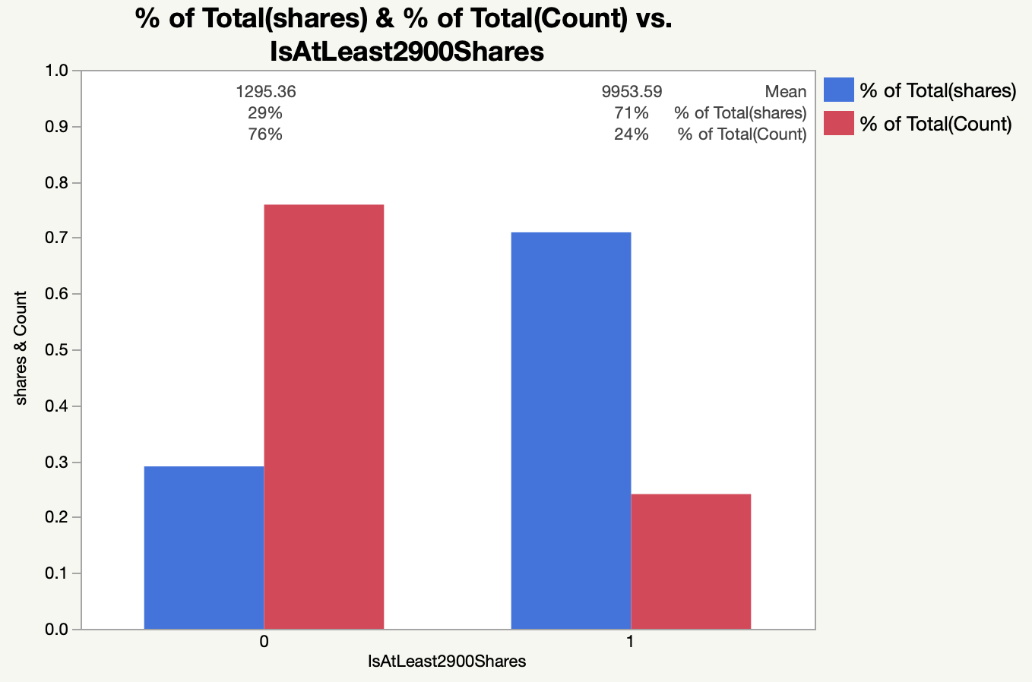
Classify target variables into 2 classes
71 %
of Total Shares
24 %
of Articles

Slide 10
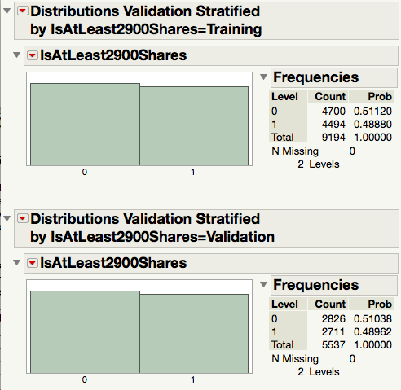
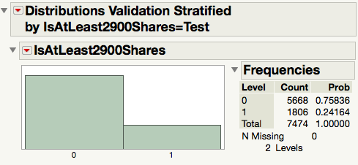
The Results of Undersampling
Notes:
We build model by lowering the occurrence of non-target event (i.e.# of 0s) in training & validation sets

Slide 11
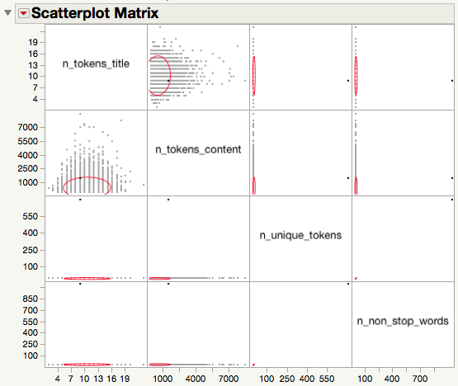
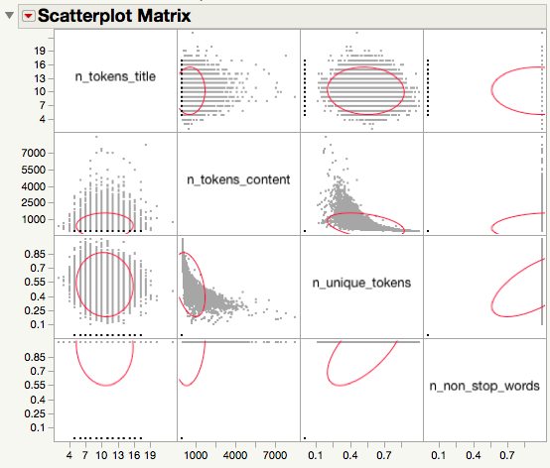
Scatterplot Matrix

Slide 12
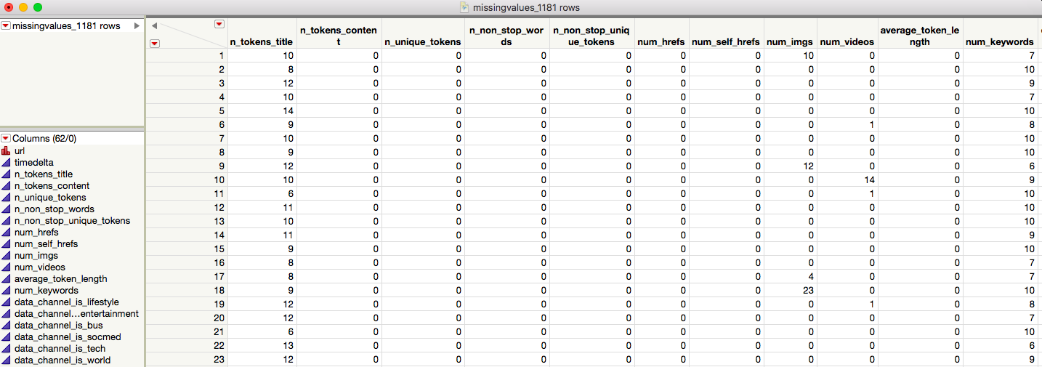
Missing Values

Slide 13
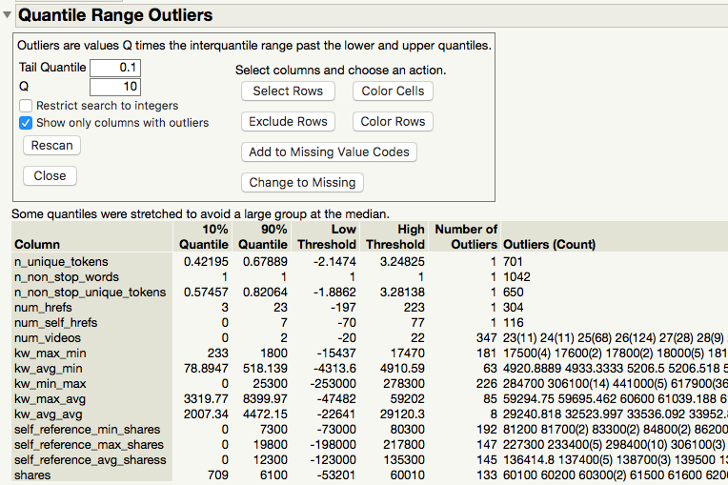
Quantile Range Outliers

Slide 14
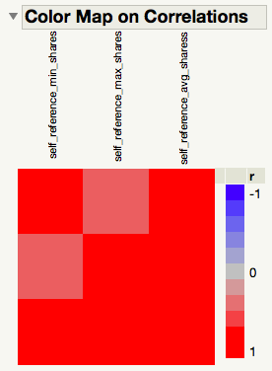
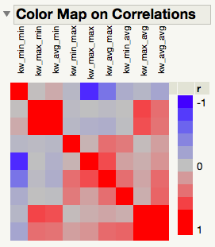
Color Map on Correlations
avg_shares
max_shares
min_shares

Slide 15
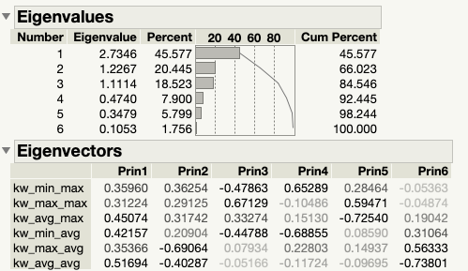
PCAs and Variable Selection
Notes:
PCAs: We decided to choose three principal components to represent six similar variables.
Variable selection: Variables contain a large portions of NLP. The results of NLP depend on researchers interpretation & programming methods. Based on results in data exploration & common sense, we selected universal variables

Slide 16
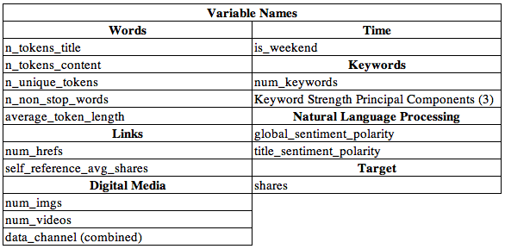
PCAs and Variable Selection
Variable Selection Standards:
Correlations
Interpretations
NLP
Poor Variable Documentation
Common Sense
Notes:
Variable selection: Variables contain a large portions of NLP. The results of NLP depend on researchers interpretation & programming methods. Based on results in data exploration & common sense, we selected universal variables

Slide 17
Models & Comparison
3

Slide 18
Models We Built
Logistic Regression
KNN
Decision Tree
Neural Network
Bootstrap Forest
Discriminant Analysis
Boosted Tree

Slide 19
Model Comparison
Models | Parameters | Values (Test data)
Forward/Mixed/Backward (Max validation R-Square) on Stratified dataset | Accuracy (in %) | 67.67
 | True positives | 1048
 | AUC | 69.21
On unstratified dataset | Accuracy (in %) | 75.63
 | RMSE | 0.4151
 | True positives | 159
 | AUC | 67.59
Decision tree with 12 splits | Accuracy (in %) | 60
 | RMSE | 0.4745
Boot strap (with 100 no. of trees) | Accuracy (in %) | 65.47
 | RMSE | 0.4612
Boosted (with 100 no. of trees) | Accuracy (in %) | 66.46
 | RMSE | 0.4694
KNN (K=81) | Accuracy (in %) | 69.307
Neural network | Accuracy (in %) | 66.1226
 | RMSE | 0.46038
Same stepwise selection process, better performance
The number of true positives increased
Higher AUC
Notes:
Aside KNN which has very limited interpretability, our two best models in terms of accuracy were logistic regression models
Forward, backward, mixed selection all yield same 17 of the 22 variables
Unstratified data set: Although accuracy was 75.63%, # of true positives was 159
Same stepwise selection process, better performance
A. The number of true positives increased ( from 159 to 1048)
B. Higher AUC
The accuracy of our best model is 67.67%

Slide 20
Results & Conclusions
4

Slide 21
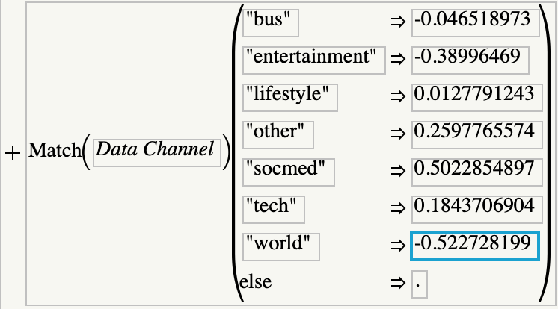
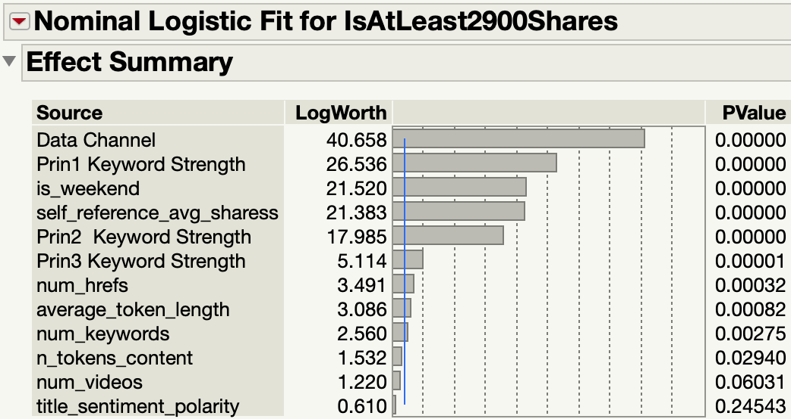
Best Model Interpretation
The following can be used as elements.

Slide 22
Post on the Weekends
Improve Keyword Strength
Focus on Popular Genres
Easiest way to improve popularity
To help articles to reach more users
Use popular references!

Slide 23
Questions?

Slide 24
THANKS!

